Slide 1

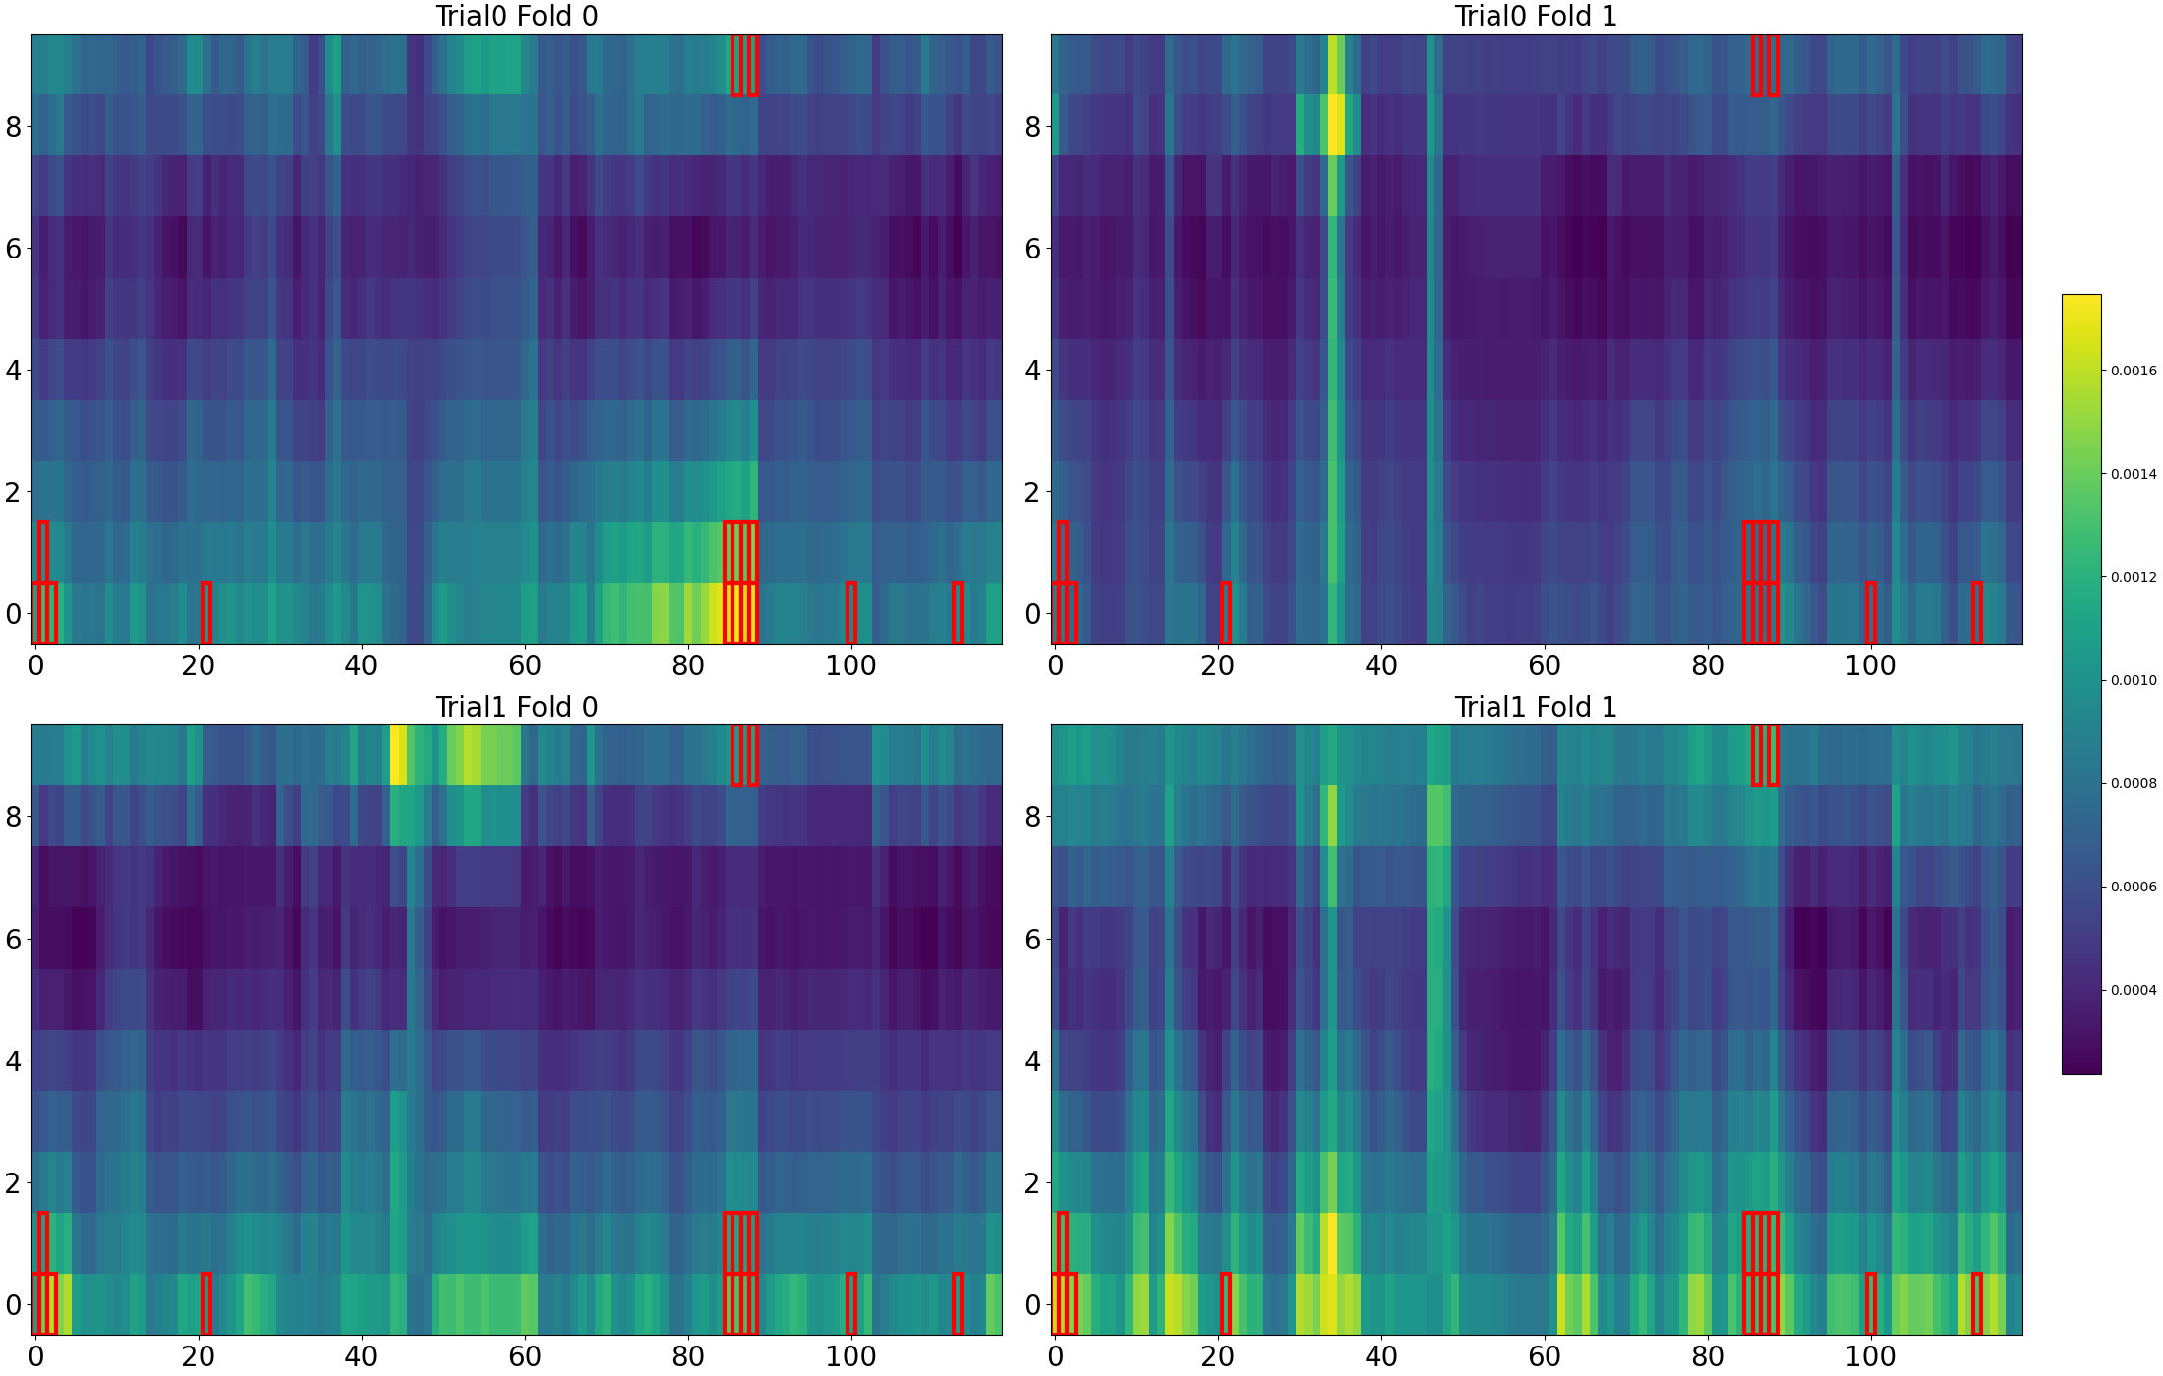
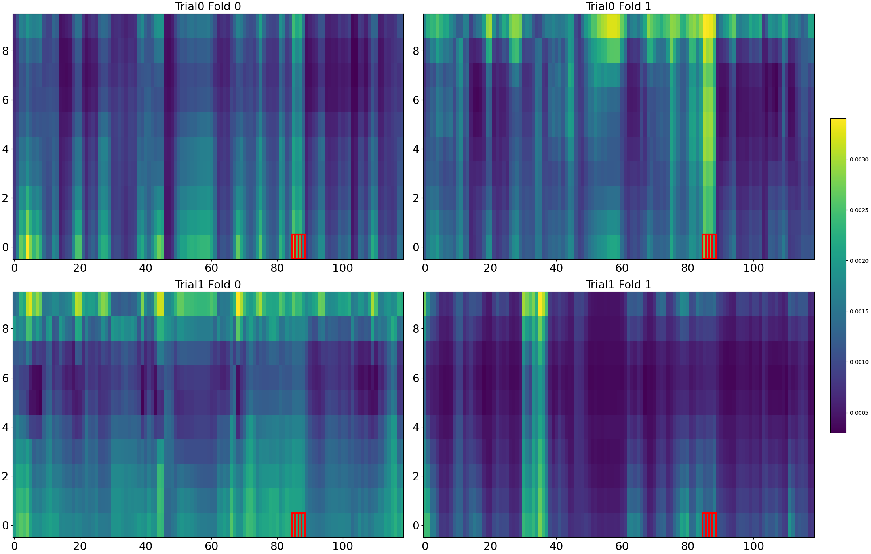
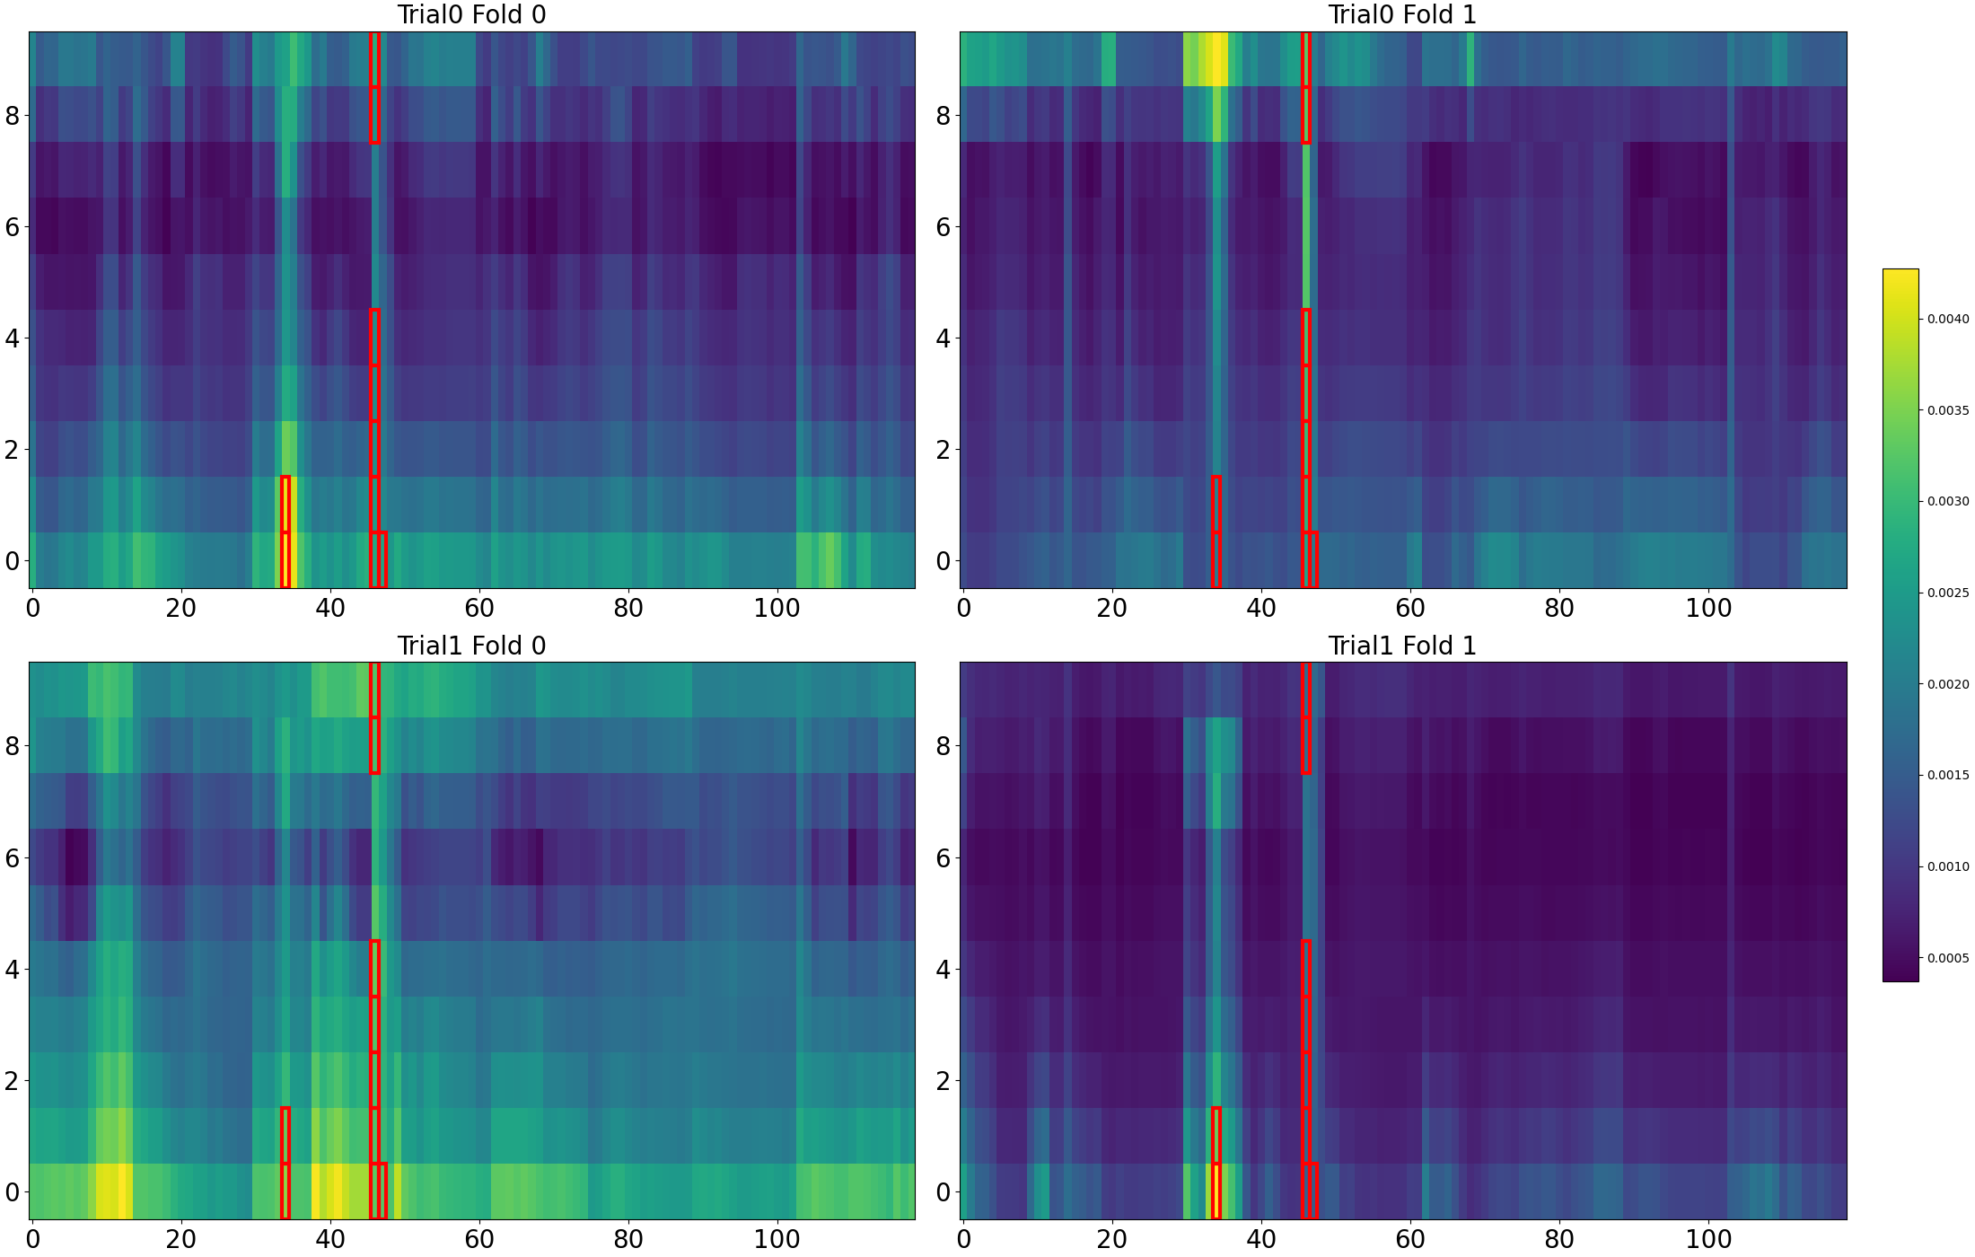
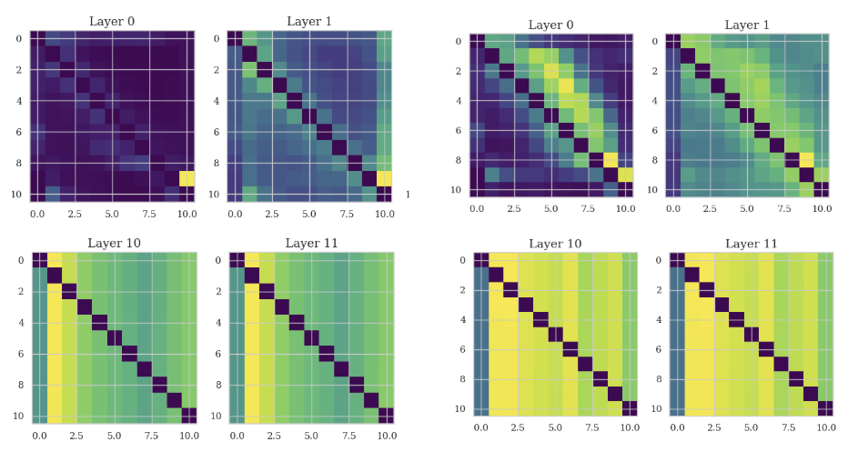
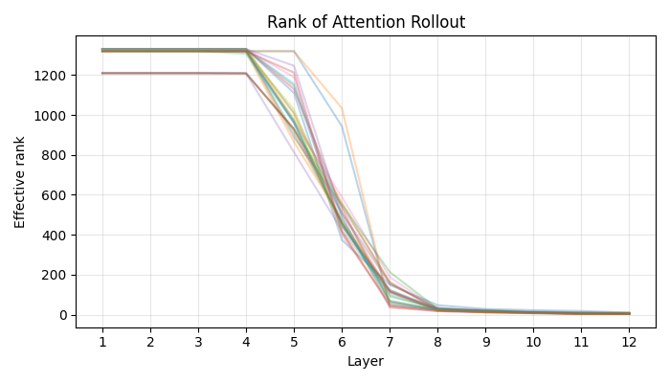

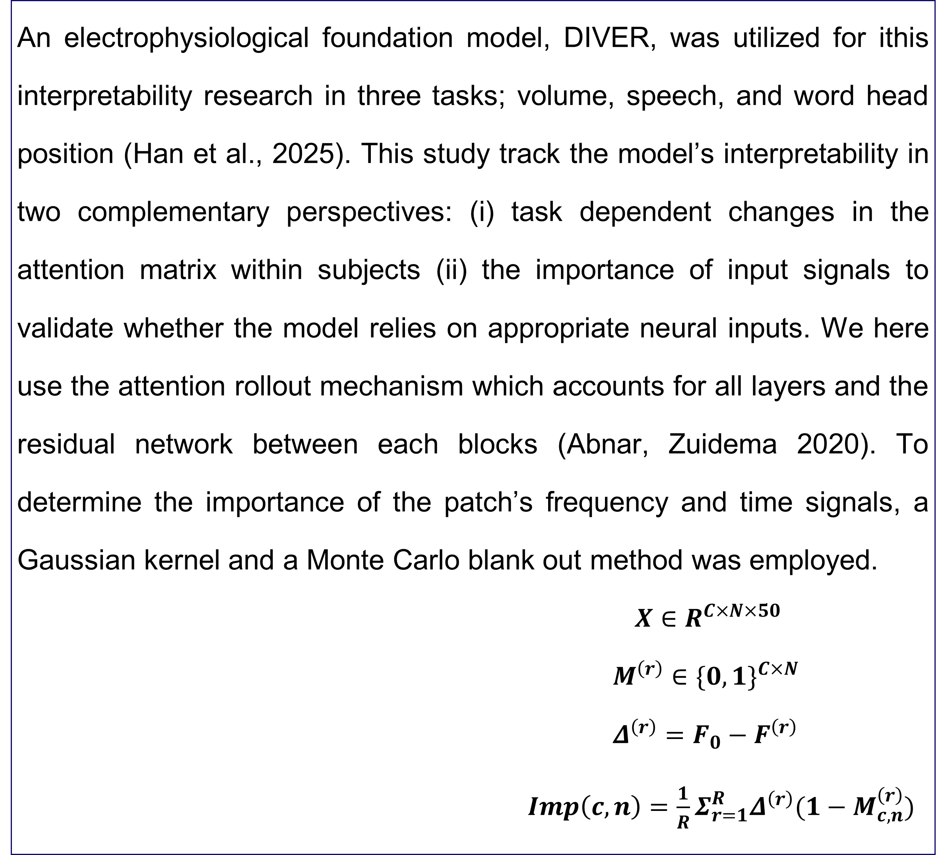
Interpretability of Electrophysiology Foundation Models
in decoding auditory processes
서울대학교 의학과
윤정원
juliaaayun@snu.ac.kr
INTRODUCTION
RESULTS
Electrophysiological signals have been a valuable source for linking brain activity with identifiable states ranging from physiological, motor, and cognitive status. Intracranial electroencephalography (iEEG) signals driven mostly from human epilepsy patients, show notably high temporal and spatial resolution. However, the inherent diversity of iEEG signals across subjects and recording conditions poses a significant barrier for task-specific supervised workflows. Foundation models, which are pretrained by self-supervised objectives and capable of capturing the data’s representations, offer an opportunity for clarifying the complex nature of electrophysiological signals (Bommasani et al., 2021). This expectation cannot be fulfilled unless the model shows robust performance against non-informative perturbations and yields biological meaningful explanations.
1. Attention rollout patterns across and within sessions
Reproducible salient attention patterns by extracting the top 10% highest-attention channel–time patches is indicated in the below. Volume engages several regions including the medial frontal gyrus, superior frontal gyrus and the amygdala. The speech task’s attention map reveals, the initial time tokens in the superior frontal gyrus (SFG) are attended the most. In the word-head-position task, the time range of salient patches is longer than the other tasks.
2. Hub connectivity across time axis and transformer layers
The connectivity between hubs in the speech task, the hippocampus and the rectus gyrus diverges at initial layers, however converges at the final
layers, corresponding with the rank collapse.
3. Perturbation analysis in frequency and time domain
Perturbation in the frequency domain using Gaussian Kernel with a standard deviation of 3 and 10 did not induce significant changes in model performance. Time domain blank out resulted into similar importance scores within trials, however significantly different scores between trials.
..
Volume | Speech | Word Head Position
OBJECTIVES
Interpretability in electrophysiology foundation models should move beyond predictive accuracy and aim to reveal whether model attributions align with established neurophysiological principles, such as task-relevant frequency bands, anatomically plausible electrode groups, and temporally localized neural dynamics. Therefore, this study aims to identify how the electrophysiology foundation model can be interpretable when decoding auditory to linguistic features, through attribution methods including attention weights saliency and input perturbations.
 | Speech | Word Head Position
Within Trial | 0.80 | 0.495
Between Trial | -0.02 | 0.09
Overlap between trial | Rectus Gyrus in the 7th patch | Frontal Inferior Sulcus in the 4th patch
METHODS
An electrophysiological foundation model, DIVER, was utilized for ithis interpretability research in three tasks; volume, speech, and word head position (Han et al., 2025). This study track the model’s interpretability in two complementary perspectives: (i) task dependent changes in the attention matrix within subjects (ii) the importance of input signals to validate whether the model relies on appropriate neural inputs. We here use the attention rollout mechanism which accounts for all layers and the residual network between each blocks (Abnar, Zuidema 2020). To determine the importance of the patch’s frequency and time signals, a Gaussian kernel and a Monte Carlo blank out method was employed.
$X∈R^{C×N×50}$
$M^{\left(r\right)}∈{\{0,1\}}^{C×N}$
$Δ^{\left(r\right)}=F_{0}−F^{\left(r\right)}$
$Imp\left(c,n\right)=\frac{1}{R}Σ_{r=1}^{R}Δ^{\left(r\right)}(1−M_{c,n}^{\left(r\right)})$
Hippocampus | Rectus Gyrus | Importance Score Similarity
CONCLUSIONS
Attention rollout values revealed task specific characteristics in spatial and temporal dimensions. These weights showed significant variances between trial and session, while input importance score showed high correlation within trials. Salient attention weights should be incorporated with more delicacy than input patches. The rank collapse in the attention rollout matrix should be elaborated, by varying depths of the model. Further, such perturbation and interpretability designs will allow understanding on which components are significant in EEG dynamics and accelerate building reliable models for broader applications
REFERENCES
Bommasani R, Hudson DA, Adeli E, Altman R, Arora S, von Arx S, et al. On the opportunities and risks of foundation models. arXiv preprint arXiv:2108.07258. 2021.
HAN, Danny Dongyeop, et al. DIVER-0: A Fully Channel Equivariant EEG Foundation Model. arXiv preprint arXiv:2507.14141, 2025.
Samira Abnar and Willem Zuidema. Quantifying attention flow in transformers. arXiv preprint arXiv:2005.00928, 2020.

